Slide 1

Data Exploration and Preparation
Diploma in DAB – L7
CCT College Dublin
Data Management and Exploratory Data Analysis
Week 3
Lecturer: Dr. Muhammad Iqbal*
Email: miqbal@cct.ie

Slide 2
Outline
Data management
Data consistency and documentation
Data dictionaries, Data quality and preprocessing
Legal, ethical and regulatory constraints
Exploratory Data Analysis
Data visualisation
Statistical properties
Univariate and multivariate analysis

Slide 3
Data Management Cycle
Data management refers to the processes used to collect, store, organize, maintain, protect and use data effectively. Data management helps to ensure that data are
Accurate: values correctly represent the real-world situation.
Complete: All required information is present without any missing values.
Consistent: the same definitions, formats and rules are used.
Accessible: authorized users can locate and understand the data.
Secure: data are protected from unauthorized access.
Documented: meaning, origin and transformations are recorded.
Example: If one system records gender as Male/Female, another uses M/F, and another uses 1/2, combining the datasets may produce inconsistencies unless these codes are documented and standardized.
Collection
Transformation
Analysis
Reporting
Archiving/ Deletion
Storage
Cleaning
Data lifecycle
Notes:
Business Perspective
Organisations use data to
Understand customers
Monitor performance
Identify trends
Predict future outcomes
Support decision-making

Slide 4
Data Consistency
Common consistency problems
Different date formats:
  21/09/2026
  2026-09-21
  Sep 21, 2026
Different units:
  kilograms versus pounds
  euro versus dollars
Inconsistent category labels:
  Ireland
  IRE
  Republic of Ireland
Spelling differences:
  Dublin
  DUBLIN
  Dubln
Duplicate records
Different definitions for the same variable.
Data consistency means that values, formats, definitions and relationships remain logically compatible throughout a dataset.
Requirement of Standard Formats
Use validation rules
Establish naming conventions
Use controlled categories
Document changes
Check datasets before combining them
Main principle: Consistent data make comparison, aggregation and analysis more reliable.

Slide 5
Documentation and the Data Dictionary
A data dictionary is documentation that explains the structure, meaning and permitted values of variables within a dataset.
Characteristics
Interprets variables consistently
Prevents incorrect assumptions
Identifies data types and permitted ranges
Makes datasets easier to share
Supports reproducibility
Helps future users to understand historical datasets.
A good data dictionary should be updated whenever the dataset structure changes.
Typical Data-dictionary Fields
Variable | Description | Type | Example | Allowed values
Student_ID | Unique student identifier | Integer | 10542 | Positive integers
Age | Student age | Integer | 24 | 18 - 100
Programme | Programme enrolled | Text | Computing | Defined programme list
Attendance | Attendance percentage | Decimal | 86.5 | 0 - 100
Status | Student status | Category | Active | Active/ Inactive

Slide 6
Data Quality and Preprocessing
Preprocessing Workflow
Real-world datasets are not ready for analysis.
Data preprocessing prepares raw data for reliable analysis. Common data-quality problems are mentioned below
Missing values
Duplicate observations
Incorrect data types
Invalid values
Inconsistent formatting
Typographical errors
Extreme or unusual observations
Inconsistent categories
Inspect the dataset: Check rows, columns, variable types and dimensions.
Identify problems: Find missing, invalid or inconsistent values.
Clean: Correct errors, remove inappropriate duplicates and standardise formats.
Transform: Create useful variables or change representations.
Validate: Confirm that cleaning has not introduced additional problems.
Document: Record what was changed and why.
Data cleaning should not simply remove inconvenient observations; decisions should have a defensible reason.

Slide 7
Legal, Ethical and Regulatory Constraints
Working with data involves responsibilities beyond the technical analysis.
Legal considerations
For organisations operating in Ireland and the EU, personal-data processing is governed principally by the General Data Protection Regulation (GDPR) and Ireland's Data Protection Act 2018. GDPR principles include
Lawfulness, fairness and transparency
Purpose limitation
Data minimisation
Accuracy
Storage limitation
Integrity and confidentiality
Accountability
Ethical considerations
Analysts should also consider
Privacy
Confidentiality
Bias and discrimination
Transparency
Representativeness
Potential harm
Responsible interpretation
Notes:
Important: Legal compliance does not automatically mean that every use of data is ethically appropriate.
Example: A dataset may legally be available for analysis, but publishing highly detailed results could still create privacy or re-identification risks.
Lawfulness, fairness and transparency: Personal data must be collected and used legally, fairly, and openly. People should know what information is being collected, why it is being collected, and how it will be used. For example, a college should clearly explain why it collects a student's contact details.
Purpose limitation: Personal data should only be collected for a specific, clear and legitimate purpose. It should not later be used for a completely different purpose without a valid reason. For example, if an email address is collected to send course information, it should not automatically be used for unrelated marketing.
Data minimization: Organisations should only collect the personal information they actually need. They should avoid collecting unnecessary details. For example, if a person's name and email address are enough to register for an event, there may be no reason to ask for their passport number.
Accuracy: Personal data should be correct and kept up to date. Incorrect information should be corrected or deleted when necessary. For example, if a student changes their address, the college should update its records.
Storage limitation: Personal data should not be kept for longer than necessary. Organisations should have rules about how long different types of information are retained and when they should be deleted or anonymised. For example, an organisation should not keep an unsuccessful job applicant's information indefinitely without a valid reason.
Integrity and confidentiality: Personal data must be kept secure and protected against unauthorised access, loss, damage or disclosure. This can involve passwords, encryption, access controls, secure storage and staff training. For example, confidential student records should only be accessible to authorised staff.
Accountability: Organisations are responsible for following GDPR and must also be able to demonstrate that they are complying with it. This can include having privacy policies, staff training, data-protection procedures, records of processing activities and appropriate security measures.
Privacy: Protecting a person’s personal information and ensuring it is only collected, used, or shared appropriately.
Confidentiality: Keeping sensitive information secret and only allowing authorised people to access it.
Bias and discrimination: Bias is an unfair preference or prejudice that can affect decisions. Discrimination happens when people are treated unfairly because of characteristics such as age, gender, race, or disability.
Transparency: Being clear and open about how information, systems, or decisions are made and used.
Representativeness: Making sure that data or samples properly reflect the different groups or people they are intended to represent.
Potential harm: Any possible negative effect that may result from using data or technology, such as financial loss, emotional distress, privacy breaches, or unfair treatment.
Responsible interpretation: Understanding and explaining data or results carefully, considering their limitations and avoiding misleading or incorrect conclusions.

Slide 8
Statistical Properties of Data
Descriptive statistics summarise important characteristics of a dataset.
Measures of central tendency
Mean, Median, Mode
Measures of spread
Range, Variance, Standard deviation and Interquartile range (IQR)
Distribution properties
Analysts should also investigate the following properties
Shape, Symmetry , Skewness , Outliers , Minimum and maximum values and Quartiles
Example: A large difference between the mean and median can indicate a skewed distribution or the influence of extreme observations.

Slide 9
Univariate Analysis
Univariate analysis examines one variable at a time.
Numerical variable example: Student Age
Questions might include
What is the average age?
What is the median?
What is the youngest student?
What is the oldest student?
How widely are ages distributed?
Are unusual values present?
Useful techniques: Mean , Median, Standard deviation, Minimum/maximum, Quartiles, Histogram and Box plot
Categorical example: Course
Questions might include:
Which Course has the most students?
How many students are in each category?
What percentage belongs to each category?
Useful techniques: Frequency tables, Percentages, Mode and Bar charts
What does this individual variable look like and discuss the properties?

Slide 10
Bivariate and Multivariate Analysis
Bivariate analysis: Examines the relationship between two variables. Examples are mentioned below
Numerical + Numerical
Study hours and examination results
Scatter plot
Correlation
Categorical + Numerical
Course and average examination result
Grouped statistics
Box plots
Categorical + Categorical
Programme and employment status
Cross-tabulation
Grouped bar chart
Multivariate analysis
Examines three or more variables simultaneously.
Example:
Exam Result = Study Hours + Attendance + Previous Result + Programme
Useful approaches can include:
Correlation matrices
Scatterplot matrices
Grouped analysis
Multiple regression
Principal Component Analysis for more advanced datasets
Correlation does not automatically establish causation.
A relationship between variables may be influenced by additional variables or other factors.

Slide 11
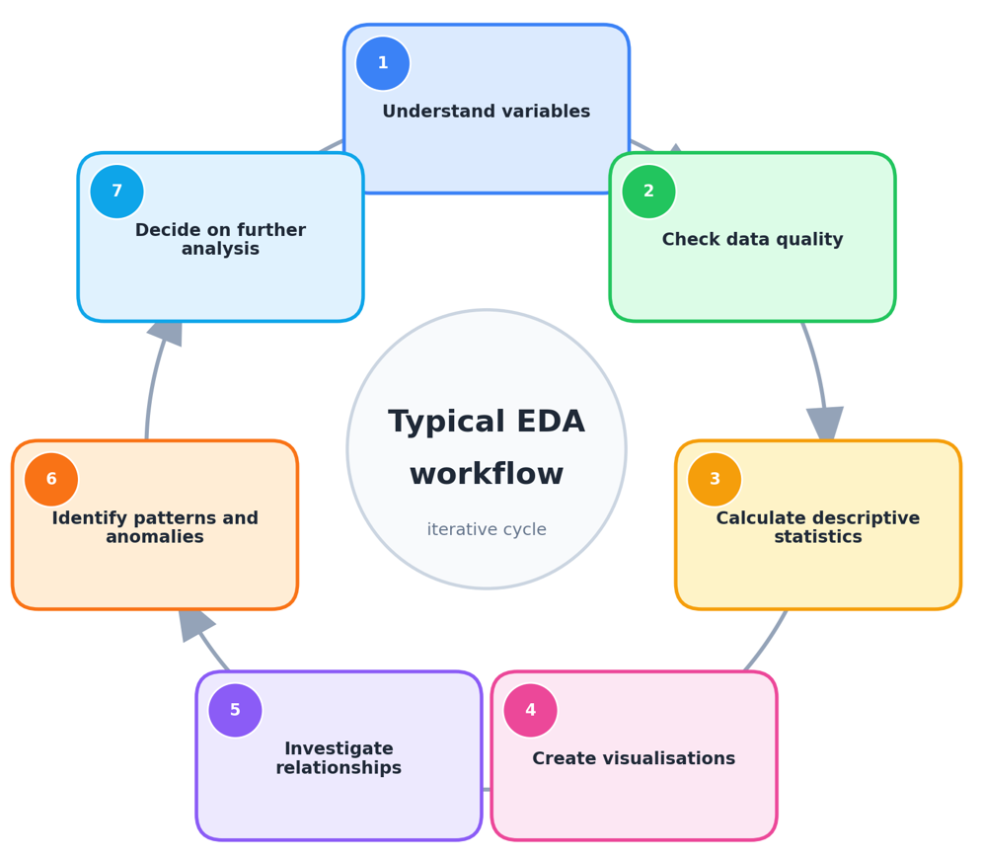
Exploratory Data Analysis (EDA)
Exploratory Data Analysis (EDA) is the process of examining data before applying formal models or drawing final conclusions.
Characteristics of EDA
Understand the structure of the dataset
Identify missing information
Detect unusual observations
Explore distributions
Discover patterns
Investigate relationships
Test assumptions
Generate questions or hypotheses
EDA combines numerical summaries and graphical exploration rather than relying on only one method.

Slide 12
Visualisation in EDA
Visualisation helps the data analysts to recognise patterns that may be difficult to identify from tables alone.
Bar chart: Useful for categorical variables. For example, number of students by programme.
Histogram: Shows the distribution of a numerical variable. For example, distribution of examination marks.
Box plot: Shows median, quartiles, spread and potential outliers.
Scatter plot: Examines relationships between two numerical variables. For example, study hours versus examination score.
Line chart: Useful for analysing changes over time.
Visualisation Principles
Choose a chart appropriate to the data type.
Give the chart a meaningful title.
Label axes clearly.
Include units.
Avoid unnecessary decoration.
Use consistent scales.
Avoid misleading axes or distorted representations.

Slide 13
Resources/ References
Pierson, L. (2026) “Data Science For Dummies”. 4th edn. For Dummies. Available at: https://learning.oreilly.com/library/view/data-science-for/9781394424085/
Foxwell, H.J. (2020) Creating Good Data: A Guide to Dataset Structure and Data Representation. Berkeley, CA: Apress. doi: 10.1007/978-1-4842-6103-3.
McGregor, S.E. (2021) Practical Python Data Wrangling and Data Quality. Sebastopol, CA: O'Reilly Media. ISBN 9781492091493.
AI Publishing (2020) Data Preprocessing with Python for Absolute Beginners: Step-by-Step Guide with Hands-on Projects and Exercises. AI Publishing LLC. ISBN 9781734790108.
Kazil, J. and Jarmul, K. (2016) Data Wrangling with Python. Sebastopol, CA: O’Reilly Media, IncOpenAI. (2026). ChatGPT. OpenAI (CCT Licensed Version).
Some images are used from Google search repository (https://www.google.ie/search) to enhance the level of learning.
Copyright Notice
The following material has been communicated to you by or on behalf of CCT College Dublin in accordance with the Copyright and Related Rights Act 2000 (the Act).
The material may be subject to copyright under the Act and any further reproduction, communication or distribution of this material must be in accordance with the Act.
Do not remove this notice

